Slide 1


Course Management system
for Woodlands University College
Prepared By
Group: ACE

Slide 2
introduction
A new electronic course management system is to be built for Woodlands University College
Paper based system caused lots of difficulties
Four key stake holders : Mr. Mark Williams, Dr. Simon White, Dr. Raj Singh, Mr. Adam Blake
Easy to access website

Slide 3
Problem Domain
Managing paper-based system is difficult for the university
Students receive grades and assignment in paper-based form
Mails and routines are unmanaged
High chances of data being misplaced or lost
Data is updated manually
Takes a lot of time to update data and information

Slide 4
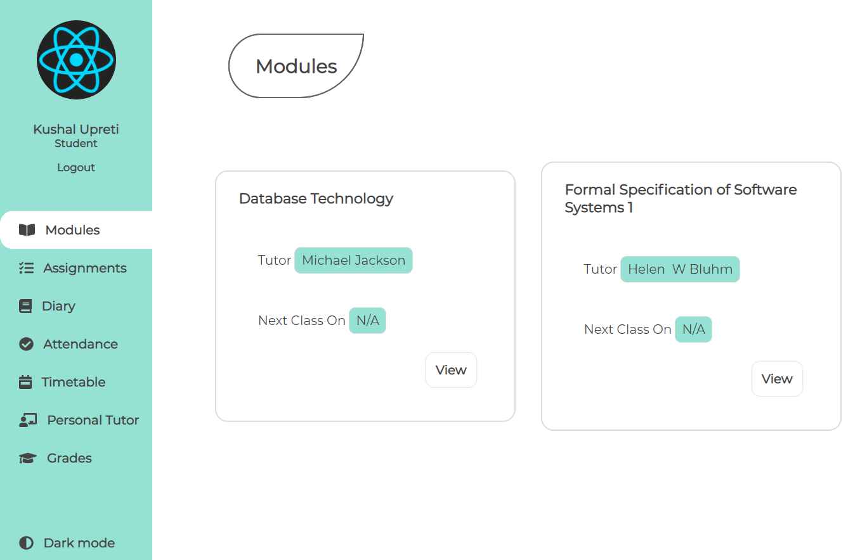
Proposed System
Built using
MySQL
Express
React
Nodejs

Slide 5
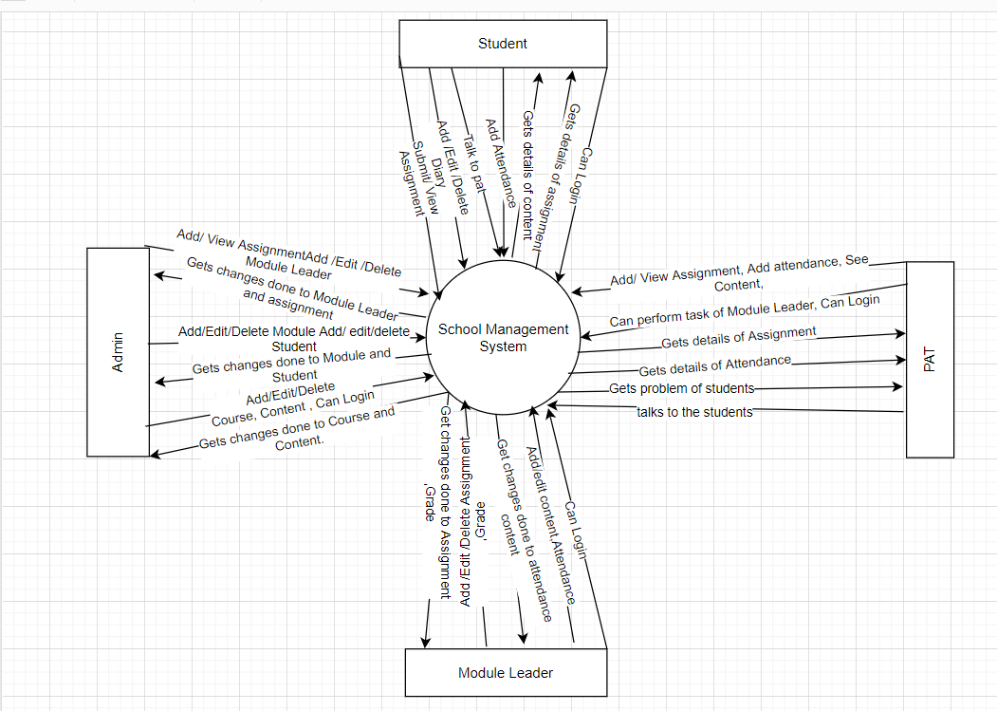
Project management
From the problem identification to testing, the project took almost 22 weeks to complete.
We implemented five days and 40 hours of work per week.
There were at max 4 people working for any given module.
There was around 15 meetings between us during the duration of the project.
The hourly wage on average was £25.
The whole project took about £8000 to complete.

Slide 6
Benefits
As it is an online system, one can access the information and perform tasks without going to college.
Data is safe and secured as we have backup of it.
Our system is easier, convenient, changeable and user friendly in nature.
Saves natural and physical resources.
Increases the productivity and increases the standard of the University
Saves time and money too and reduces the workload.

Slide 7
Future works
Our System is not yet complete. There are some the functionalities that doesn't exist in our system, but we are working to add in the future.
These are as follows:
File/Image/Video Upload
Payment System
Online Exams
Virtual Class
E-Library
And many more

Slide 8
Conclusion
Our web application helps to solve many existing problems of clerical based system.
It is designed for easy management, increasing productivity and cost efficiency.
The system is highly maintainable which means new features or changes can be implemented easily.
Thank you

